Slide 1

Urban Acoustics
Week 4 Tutorial
Conceptual questions prof.dr.ir. Maarten Hornikx dr. Matthias Cosnefroy

Slide 2
Conceptual questions
1. Scattering due to atmospheric turbulence leads to decorrelation of sound waves.
Answer
Right. Turbulent scattering induces unsteady fluctuations in the amplitude and phase of the wave which reduces the auto-correlation of the wave in case of a single wave (and cross-correlation in case of the direct and reflected waves).
7S0X0
2017/02/09
PAGE 1
PAGE <number>

Slide 3

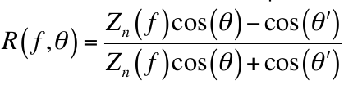
Conceptual questions
2. The acoustic absorption coefficient α of a ground surface can be computed using the surface impedance Z_{n}.
Answer
Right. The acoustic absorption coefficient can be calculated from the surface impedance with
with the reflection factor
7S0X0
2017/02/09
PAGE 2
PAGE <number>

Slide 4
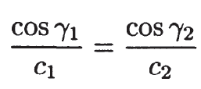
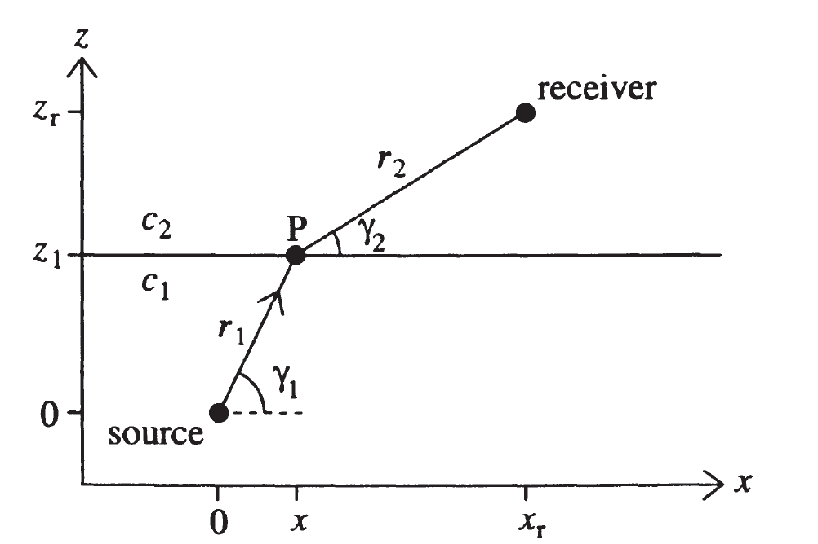
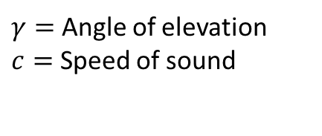
Conceptual questions
3. Sound waves are bent towards regions with lower sound speeds
(assuming no influence of the wind on sound propagation).
Answer:
• Right. From Snell’s law of refractive index (given below), sound waves
are bent towards regions with lower sound speeds (here, c₂>c₁).
Computational Atmospheric Acoustics. Erik M. Salomons, 2001
PAGE 3
7S0X0
2017/02/09
PAGE <number>

Slide 5
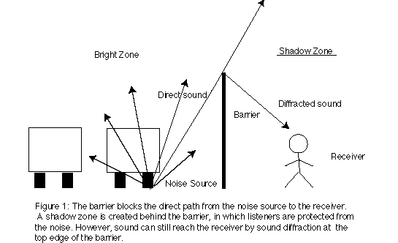
Conceptual questions
4. Diffraction at the edge of a barrier leads to acoustic energy in the area behind the barrier, where the sound source is not visible.
Answer
Right. See figure 1.
Penelope Menounou, Ilene J. Busch-Vishniac, David T. Blackstock; Jagged-edge Noise Barriers; ICA/ASA '98
7S0X0
2017/02/09
PAGE 4
PAGE <number>

Slide 6
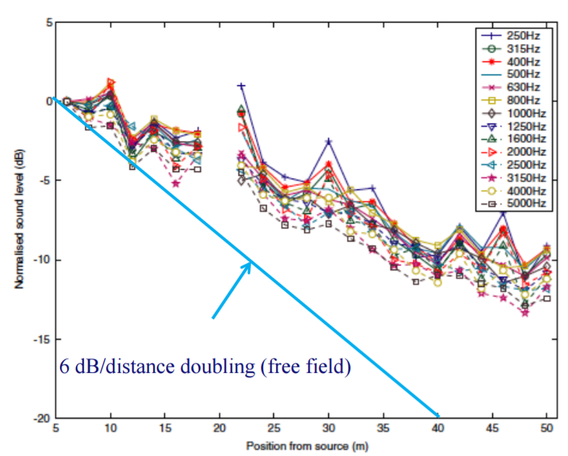
Conceptual questions
5. In narrow urban street canyons, the sound level does not decay with increasing distance from the source.
Answer
Wrong. There is a decay, although it does not follow the 6dB / distance doubling as in free field. See figure below.
Picaut, J., Le Polles, T., L’Hermite, T., Gary, V. Experimental study of sound propagation in a street. App. Acoust. 66 (2005) 149–173
7S0X0
2017/02/09
PAGE 5
PAGE <number>

Slide 7
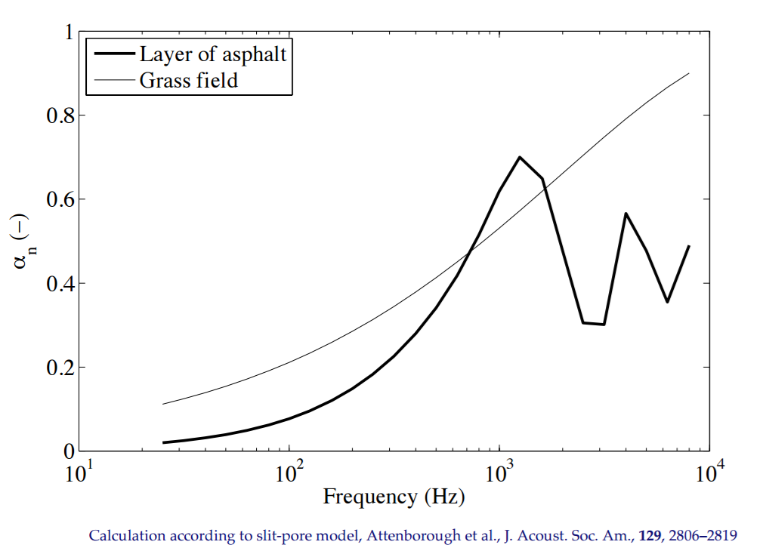
Conceptual questions
6. The acoustic absorption coefficient α of porous ground surfaces (like grass) usually decreases with increasing frequency.
Answer
Wrong. The absorption coefficient of porous ground surfaces increases or oscillates with increasing frequency. See figure below.
7S0X0
2017/02/09
PAGE 6
PAGE <number>

Slide 8
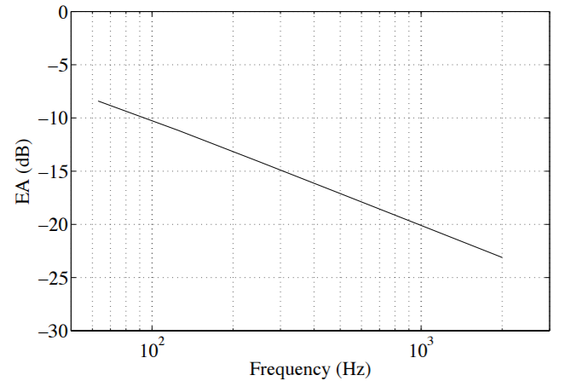
Conceptual questions
7. Screening of sound by barriers reduces sound levels for all audible frequencies.
Answer
Right. But the amount of attenuation depends on the frequency.
7S0X0
2017/02/09
PAGE 7
PAGE <number>

Slide 9
Conceptual questions
8. The amount of air absorption in dB/m does depend on the wind velocity.
Answer
Wrong. Air absorption depends on the frequency, temperature, humidity, and air pressure.
7S0X0
2017/02/09
PAGE 8
PAGE <number>

Slide 10
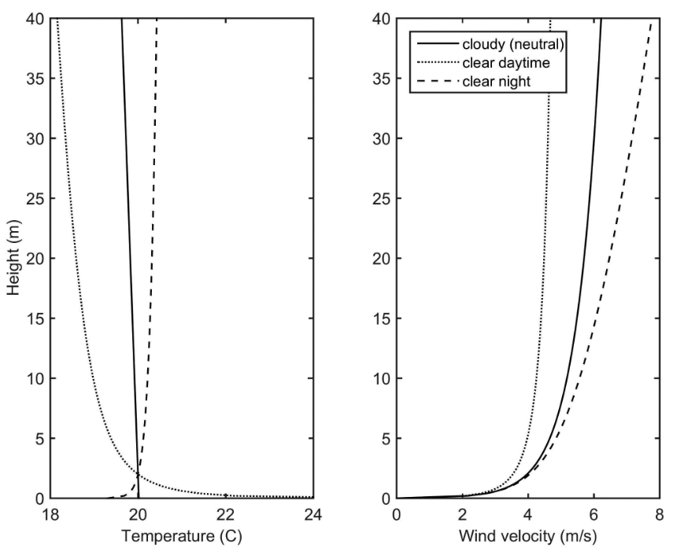
Conceptual questions
9. The temperature in the atmospheric surface layer usually increases with height.
Answer
Wrong. The temperature in the atmospheric surface layer increases with height at night, but not in clear daytime or neutral conditions. See figure.
Acoustics in Moving Inhomogeneous Media; Vladimir E.Ostashev, Keith D.Wilson; 2016
7S0X0
2017/02/09
PAGE 9
PAGE <number>

Slide 11
Conceptual questions
10. Sound waves are refracted by high wind velocities.
Answer
Wrong. Sound waves are refracted by varying wind velocities.
7S0X0
2017/02/09
PAGE 10
PAGE <number>

Slide 12
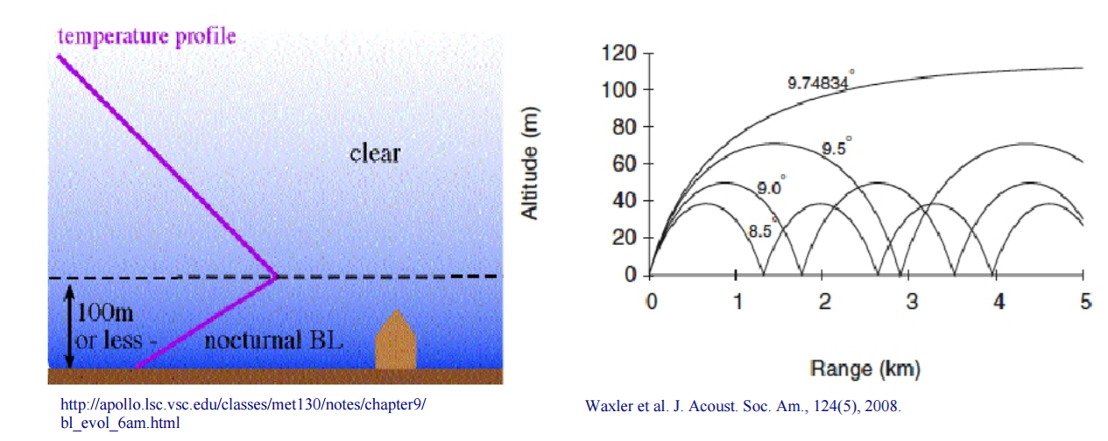
Conceptual questions
11. In the nocturnal boundary layer, sound waves are bent upwards
Answer
Wrong. The sound waves are bent downwards due to the temperature inversion at night (the temperature increases with height).
7S0X0
2017/02/09
PAGE 11
PAGE <number>

Slide 13
Conceptual questions
12. Scattering due to atmospheric turbulence increases the air absorption of sound waves.
Answer
Wrong. Turbulence effects have nothing to do with air absorption.
7S0X0
2017/02/09
PAGE 12
PAGE <number>

Slide 14
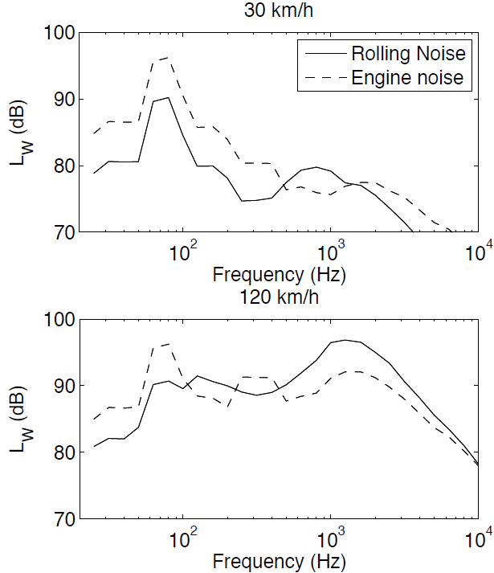
Conceptual questions
13. Screening of sound by barriers is most efficient to reduce noise from road traffic vehicles at a low speed.
Answer
Wrong. Higher speeds produce higher noise levels at higher frequencies (see figure). Attenuating capacity of barriers are better at higher frequencies.
7S0X0
2017/02/09
PAGE 13
PAGE <number>

Slide 15
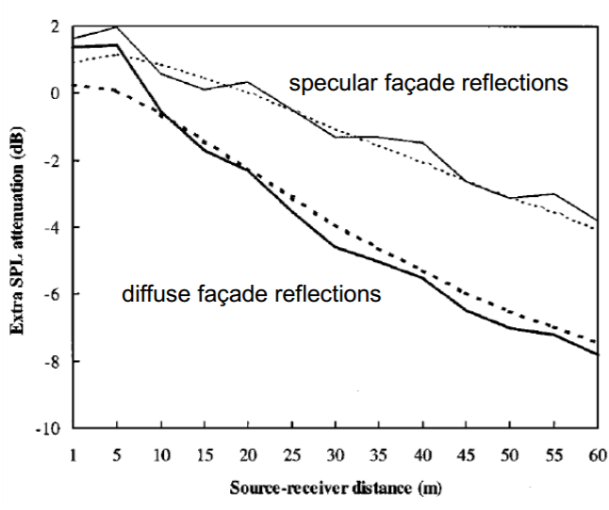
Conceptual questions
14. In narrow urban street canyons, sound reduction over increasing source-receiver distance is larger when sound reflection from façades is specular (i.e., mirror-like) instead of diffuse.
Answer
Wrong. Sound reduction is larger with diffuse reflections: more energy escapes the canyon since the waves are reflected in all directions.
7S0X0
2017/02/09
PAGE 14
PAGE <number>

Slide 16
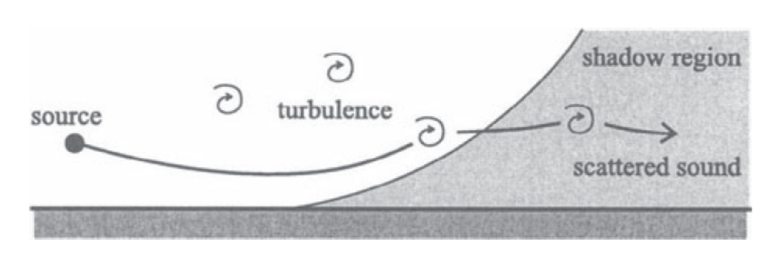
Conceptual questions
15. Scattering due to atmospheric turbulence leads to higher sound levels in acoustic shadow zones.
Answer
Right. In an upward refracting atmosphere, turbulent scattering makes the sound waves penetrate into the shadow region.
7S0X0
2017/02/09
PAGE 15
PAGE <number>

Slide 17
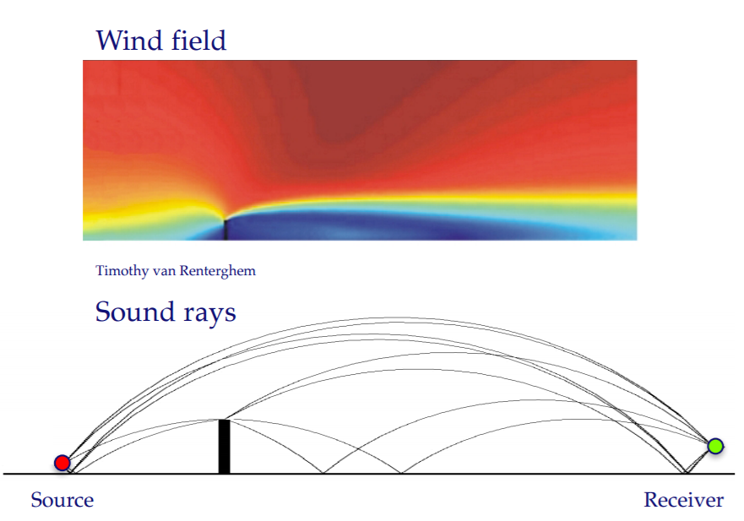
Conceptual questions
16. If the wind blows from a source towards a receiver (downwind configuration), with a noise barrier in between, the performance of the barrier is worse than in the absence of wind.
Answer
Right. Because of downward refraction, acoustic waves travel above the barrier and are refracted towards the receiver.
7S0X0
2017/02/09
PAGE 16
PAGE <number>

Slide 18
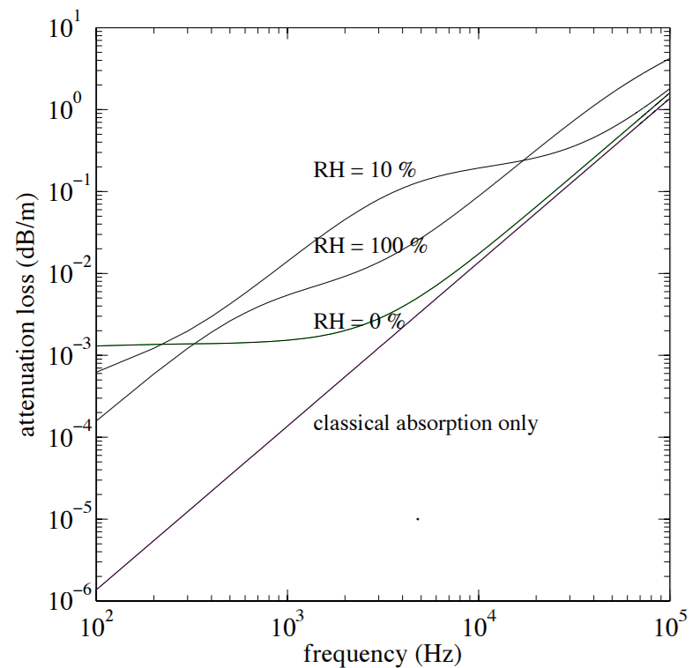
Conceptual questions
17. The attenuation loss due to the molecular absorption in air is linearly proportional to the sound frequency.
Answer
Wrong. The attenuation loss is non-linearly proportional to the frequency.
7S0X0
2017/02/09
PAGE 17
PAGE <number>

Slide 19
Conceptual questions
18. Atmospheric turbulence leads to sound pressure levels behind noise barriers that are lower than in the absence of atmospheric turbulence.
Answer
Wrong. Similar to the refractive shadow region, turbulence scatters noise behind the barriers, thus increasing the sound levels.
7S0X0
2017/02/09
PAGE 18
PAGE <number>

Slide 20
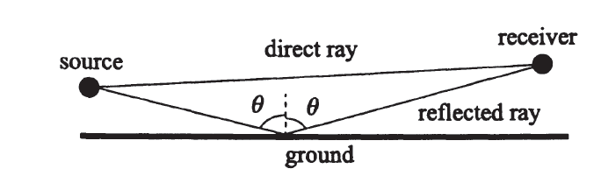
Conceptual questions
19. The sound field due to a direct sound wave (from the source) and its reflection on the ground can lead to a sound level smaller than the level of the direct wave alone.
Answer
Right. Destructive interference between the direct and the reflected waves can occur depending on the frequency and on the position of the receiver.
7S0X0
2017/02/09
PAGE 20
PAGE <number>

Slide 21
Conceptual questions
20. The refraction of acoustic waves by the wind does not depend on the frequency.
Answer
Right. The refraction of acoustic waves does not depend on the frequency because the sound speed does not depend on the frequency (i.e., air is not a dispersive medium).
However, a frequency dependence can be observed compared to a no-wind case due to a modification of the interference between the direct and ground-reflected waves.
7S0X0
2017/02/09
PAGE 19
PAGE <number>

Slide 22
Conceptual questions
21. The amount of air absorption (in dB/m) depends on the molecular composition of air.
Answer
Right. In addition to the viscous and thermal effects (i.e., the “classical absorption”), the air absorption also depends on the relaxation and compression of the molecules in air (e.g., nitrogen and oxygen).
7S0X0
2017/02/09
PAGE 21
PAGE <number>

Slide 23
Questions?
m.h.r.cosnefroy@tue.nl
7S0X0 / 7W8X0
05/03/2020
PAGE 22
2017/02/09
PAGE <number>

